Slide 1

Ongoing projects update
Spenser Burrows

Slide 2
Tasks spreadsheet
The spreadsheet “Tasks for Spenser” can be used to request changes to or report problems with the database system
Links to this spreadsheet are located on the desktop of the pelletron control computer and on the server in Z:\DatabaseProject and Z:\burrowss

Slide 3
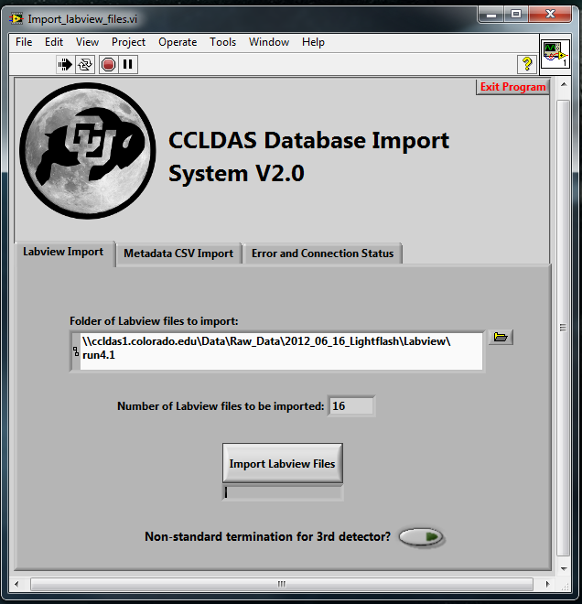
Old data import
An import VI exists that is capable of importing old labview waveform files or data from old .csv files into the database

Slide 4
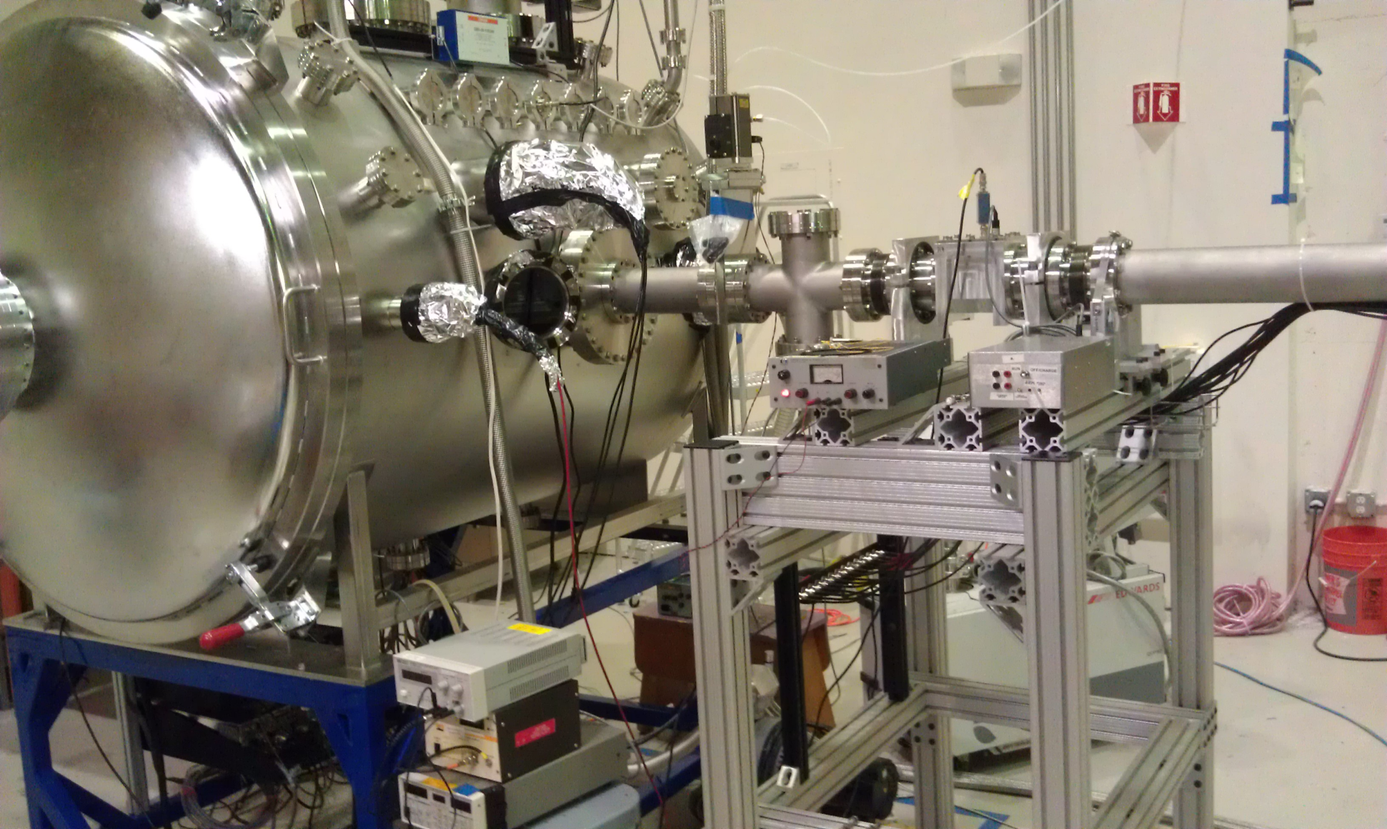
Possible interlock system redesign

Slide 5
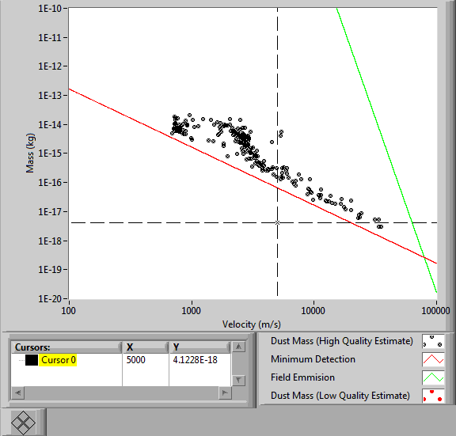
Internet database interface

Slide 6
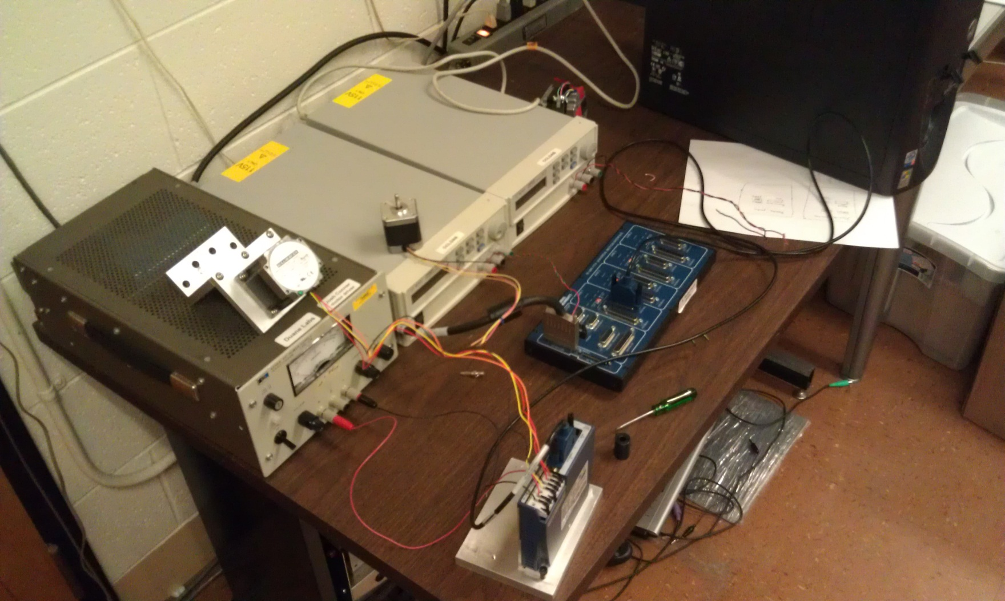
Labview stepper motor control

Slide 7
?

